Slide 1
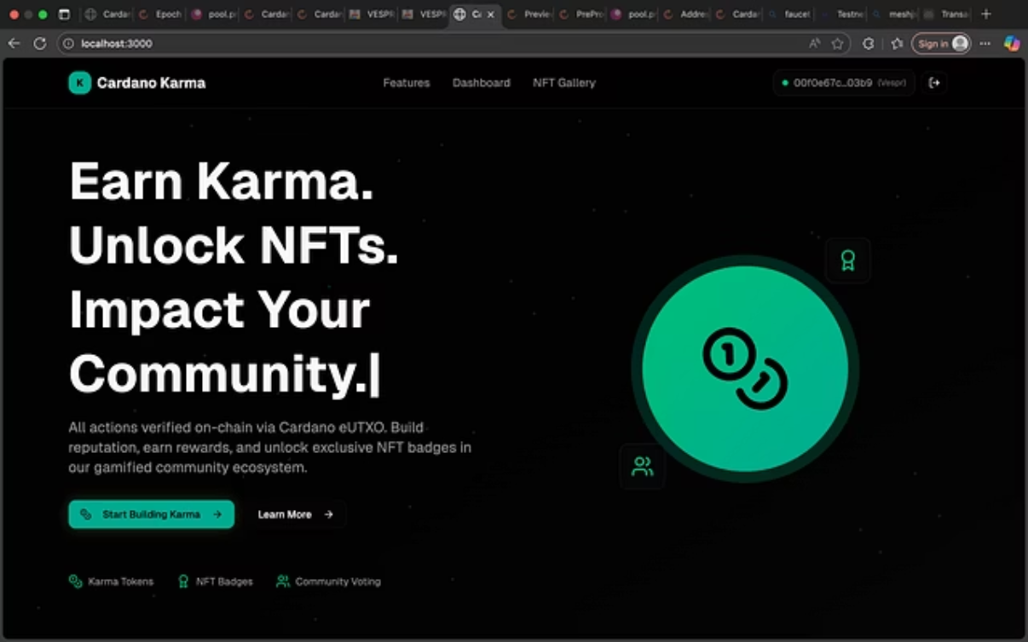
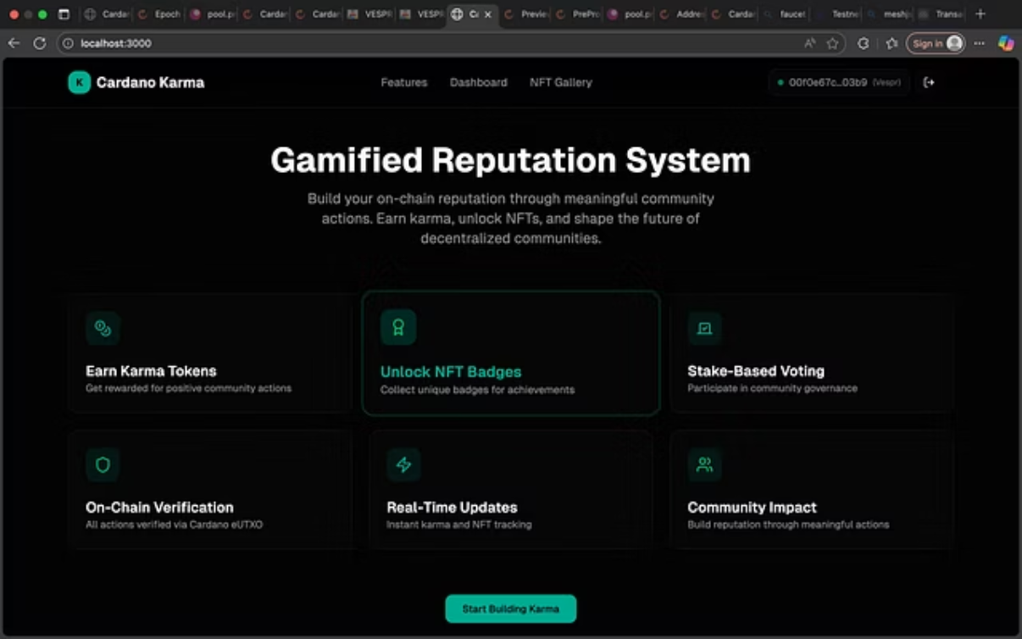
Cardano Karma
Build an on-chain reputation system where users earn karma tokens and NFT badges. Fully interactive, responsive, and gamified UI with Wallet Connect, Admin controls, and Blockchain API integration.

Slide 2
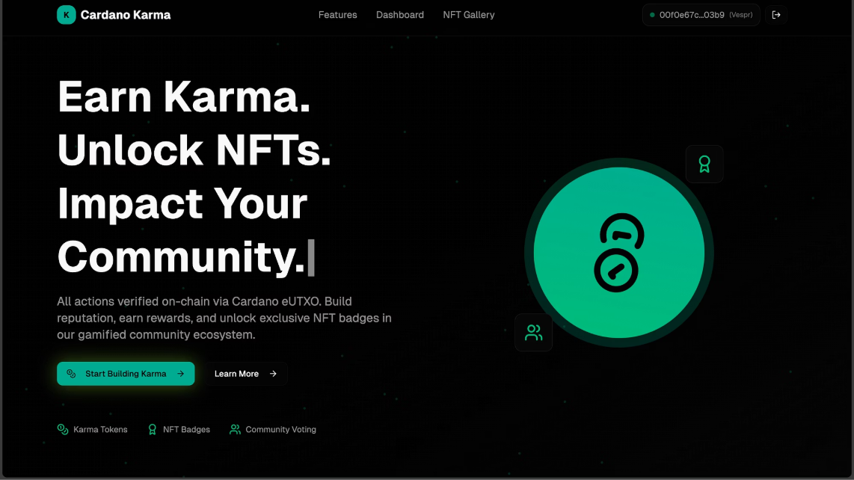
Landing Page Design
Hero Section Components
Hero Content
CTA Buttons
Title: "Earn Karma. Unlock NFTs. Impact Your Community."
"Connect Wallet" → Glowing gradient + hover scale
Subtitle: "All actions verified on-chain via Cardano eUTXO."
"Learn More" → Ripple effect
Key Interactions
Connect Wallet → Lucid Evolution integration
Background Elements
Store wallet address in Global State
Animated gradient with floating particles
Smooth scroll to Features section
Spinning Karma token hero animation

Slide 3




Features Section
Earn Karma Tokens
Unlock NFT Badges
Stake-Based Voting
Complete community actions to earn on-chain karma tokens with animated counters
Reach milestones to mint unique NFT badges with sparkle effects and confetti
Participate in community governance with weighted voting based on karma points
Interactions: Sequential fade-in animation on scroll, hover lift effects, and detailed modals on click

Slide 4
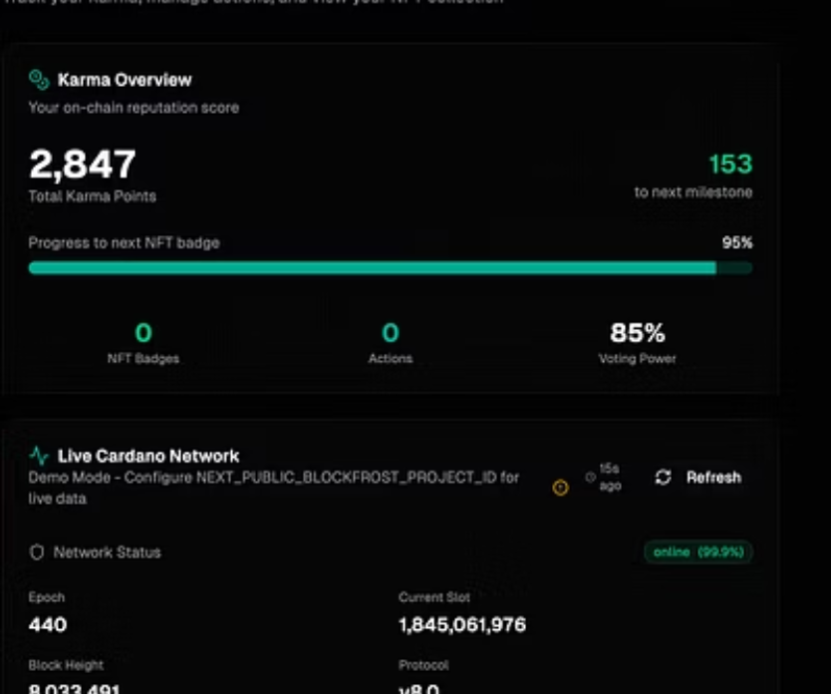
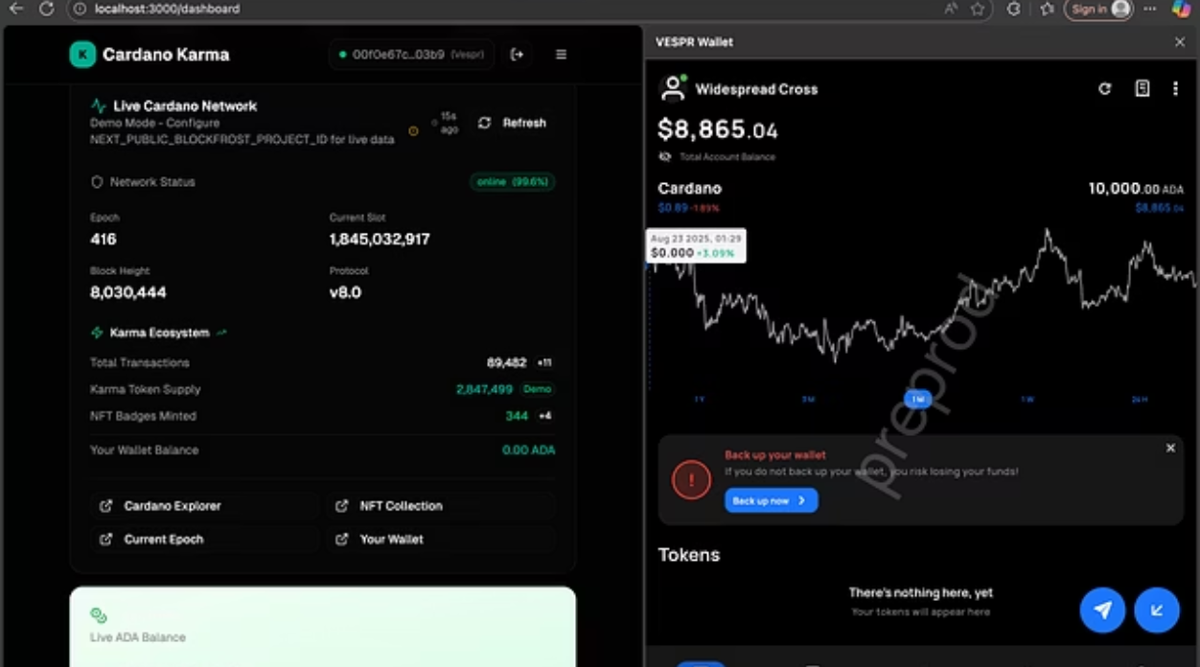
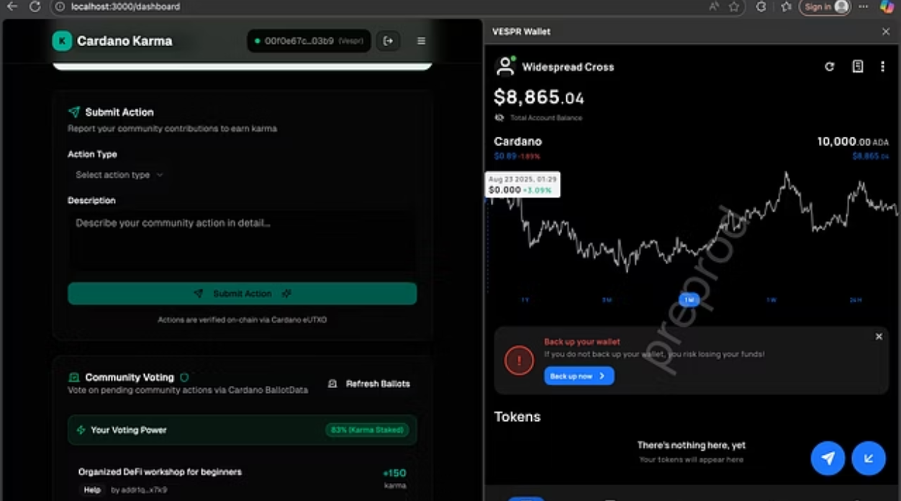
User Dashboard Components
Wallet & Karma Card
Action Submission Panel
NFT Badge Gallery
Wallet address display
Text input for action description
Masonry grid layout
Total karma points with animated counter
Action type dropdown menu
Flip animation on hover
Submit button with ripple + confetti
Confetti on badge unlock
Recent actions line chart

Slide 5
Dashboard Interactions
01
02
Submit Action
Karma Minted
Triggers smart contract transaction with dummy ADA + datum structure
Updates animated counter and progress bar with smooth fill animation
03
04
NFT Milestone
Voting Actions
Auto-triggers badge display in gallery with scale and confetti effects
Cardano Ballot API integration with atomic points updates

Slide 6





End-to-End User Journey
Connect & Load
Landing page → wallet connection → dashboard loads with karma points
Submit Action
User action → smart contract validation → UTXO creation
Earn Rewards
Karma tokens minted → progress bar updated → milestone reached
Unlock Badges
NFT badge minted → gallery updated with confetti animation
Community Voting
Optional voting → action approval → points updated atomically

Slide 7




Ready to Build
Fully Responsive
Interactive & Gamified
Mobile-first design with adaptive layouts
Web3 UI with comprehensive animations
Ready for Implementation
Pre-defined actions, APIs, and integrations
Outcome: A complete Web3 UI ready for Bolt visual coding with all interactions, animations, and blockchain integrations fully specified

